Slide 1
NOSQL-2: CYAEC49

Slide 2
Course Outline
Unit I
Introduction
Hbase: Introduction, Architecture, Hbase vs RDBMS, Shell Commands, Create Table, Insert & Retrieve Data, Performance Bottlenecks. .

Slide 3
Course Outline
Unit II
Hive: Introduction, Data types, Create & Drop Database, Create/Alter/Drop Table, Static Partitioning, Dynamic Partitioning. HiveQL: Operators, Functions

Slide 4
Course Outline
Unit III
HiveQL: Group By and Having, Order By, Sort By, Join.Redis:
Introduction, Features, Datatypes, Keys, String.

Slide 5
Course Outline
Unit IV
Graph Databases: Introduction, Features, Graph data in a relational database, Querying graph data using MySQL, Neo4j in NoSQL space, Key-value stores, Column-family stores

Slide 6
Course Outline
Unit V
Data modeling in Neo4j, Neo4j CQL Read/Write Clauses: Set Clause, Delete clause, Remove clause, Foreach clause, Match clause, Where clause, Count Function, Order by clause, Limit, skip, String Functions, Aggregate Function.

Slide 7
Textbooks
Text Books: 1. Edward Capriolo, Dean Wampler, Jason Rutherglen, “Programming Hive”, O'Reilly Media, Inc., 2012.
2. Tiago Macedo, Fred Oliveira, “Redis Cookbook”, O'Reilly Media, Inc., July 2011.

Slide 8
Reference Books
1.Lars George, “HBase: The Definitive Guide”, O'Reilly Media, Inc, 2011.
2. Edward Capriolo, Dean Wampler and Jason Rutherglen, Programming Hive, O'Reilly Media, Inc., 2012.
3. https://neo4j.com/docs/cypher-manual. 4. Tiago Macedo and Fred Oliveira, Redis Cookbook, O'Reilly Media, Inc, 2011.

Slide 9
Course Outcomes
At the end of the course, the student will be able to:
1.Understand the fundamental of HBase and the bottlenecks.
2. Learn about Hive Partitioning, HiveQL and operators.
3. Know the different types of NoSQL databases, its features and functions.
4. Understand the Graph Databases and querying graph data using MySQL.
5. Apply Create, update and delete data from Neo4j and Hive using the Query Language.

Slide 10
Course Assessment
CIE- 30 Marks
Test question paper pattern is
Part=A MCQ-6 Marks and
Part-B writing 24 Marks
20 Marks Component:
Case Study– 10 Marks
Assignment-10 Marks

Slide 11


Slide 12
Unit-1
Introduction

Slide 13
HBase
HBase is a data model that is similar to Google’s big table. It is an open source, distributed database developed by Apache software foundation written in Java. HBase is an essential part of our Hadoop ecosystem. HBase runs on top of HDFS (Hadoop Distributed File System). It can store massive amounts of data from terabytes to petabytes. It is column oriented and horizontally scalable.

Slide 14
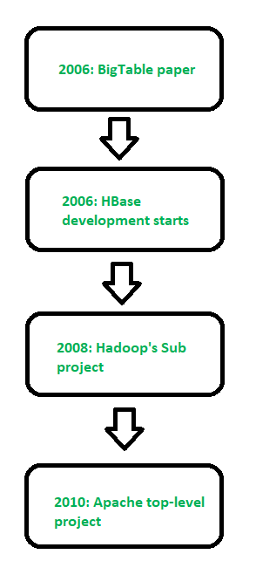
History of HBase

Slide 15
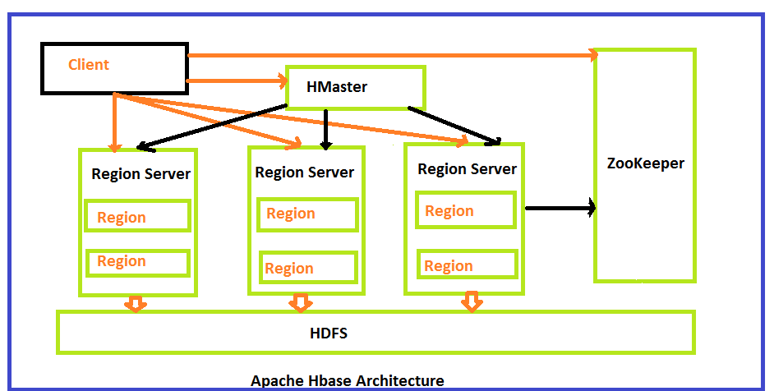
Architecture of HBase

Slide 16
Architecture of HBase
HMaster in HBase is the implementation of a Master server in HBase architecture. It acts as a monitoring agent to monitor all Region Server instances present in the cluster and acts as an interface for all the metadata changes. In a distributed cluster environment, Master runs on NameNode. Master runs several background threads.
The following are important roles performed by HMaster in HBase.
Plays a vital role in terms of performance and maintaining nodes in the cluster.
HMaster provides admin performance and distributes services to different region servers.
HMaster assigns regions to region servers.
HMaster has the features like controlling load balancing and failover to handle the load over nodes present in the cluster.
When a client wants to change any schema and to change any Metadata operations, HMaster takes responsibility for these operations.
Some of the methods exposed by HMaster Interface are primarily Metadata oriented methods.

Slide 17
Architecture of HBase
HBase Region Servers
When HBase Region Server receives writes and read requests from the client, it assigns the request to a specific region, where the actual column family resides. However, the client can directly contact with HRegion servers, there is no need of HMaster mandatory permission to the client regarding communication with HRegion servers. The client requires HMaster help when operations related to metadata and schema changes are required.
HRegionServer is the Region Server implementation. It is responsible for serving and managing regions or data that is present in a distributed cluster. The region servers run on Data Nodes present in the Hadoop cluster.
HMaster can get into contact with multiple HRegion servers and performs the following functions.
Hosting and managing regions
Splitting regions automatically
Handling read and writes requests
Communicating with the client directly

Slide 18
Application of HBase
Real-time analytics: HBase is an excellent choice for real-time analytics applications that require low-latency data access. It provides fast read and write performance and can handle large amounts of data, making it suitable for real-time data analysis.
Social media applications: HBase is an ideal database for social media applications that require high scalability and performance. It can handle the large volume of data generated by social media platforms and provide real-time analytics capabilities.
IoT applications: HBase can be used for Internet of Things (IoT) applications that require storing and processing large volumes of sensor data. HBase’s scalable architecture and fast write performance make it a suitable choice for IoT applications that require low-latency data processing.
Online transaction processing: HBase can be used as an online transaction processing (OLTP) database, providing high availability, consistency, and low-latency data access. HBase’s distributed architecture and automatic failover capabilities make it a good fit for OLTP applications that require high availability.
Ad serving and clickstream analysis: HBase can be used to store and process large volumes of clickstream data for ad serving and clickstream analysis. HBase’s column-oriented data storage and indexing capabilities make it a good fit for these types of applications.

Slide 19
Features of HBase
1. It is linearly scalable across various nodes as well as modularly scalable, as it divided across various nodes.
HBase provides consistent read and writes.
It provides atomic read and write means during one read or write process, all other processes are prevented from performing any read or write operations.
It provides easy to use Java API for client access.
It supports Thrift and REST API for non-Java front ends which supports XML, Protobuf and binary data encoding options.
It supports a Block Cache and Bloom Filters for real-time queries and for high volume query optimization.
HBase provides automatic failure support between Region Servers.
It support for exporting metrics with the Hadoop metrics subsystem to files.
It doesn’t enforce relationship within your data.
It is a platform for storing and retrieving data with random access.

Slide 20
RDBMS VS HBase
RDBMS Vs HBase –
RDBMS is mostly Row Oriented whereas HBase is Column Oriented.
RDBMS has fixed schema but in HBase we can scale or add columns in run time also.
RDBMS is good for structured data whereas HBase is good for semi-structured data.
RDBMS is optimized for joins but HBase is not optimized for joins.
Apache HBase is a NoSQL, column-oriented database that is built on top of the Hadoop ecosystem. It is designed to provide low-latency, high-throughput access to large-scale, distributed datasets.

Slide 21
Advantages of HBase
Scalability: HBase can handle extremely large datasets that can be distributed across a cluster of machines. It is designed to scale horizontally by adding more nodes to the cluster, which allows it to handle increasingly larger amounts of data.
High-performance: HBase is optimized for low-latency, high-throughput access to data. It uses a distributed architecture that allows it to process large amounts of data in parallel, which can result in faster query response times.
Flexible data model: HBase’s column-oriented data model allows for flexible schema design and supports sparse datasets. This can make it easier to work with data that has a variable or evolving schema.
Fault tolerance: HBase is designed to be fault-tolerant by replicating data across multiple nodes in the cluster. This helps ensure that data is not lost in the event of a hardware or network failure.

Slide 22
Disadvantages of HBase
Complexity: HBase can be complex to set up and manage. It requires knowledge of the Hadoop ecosystem and distributed systems concepts, which can be a steep learning curve for some users.
Limited query language: HBase’s query language, HBase Shell, is not as feature-rich as SQL. This can make it difficult to perform complex queries and analyses.
No support for transactions: HBase does not support transactions, which can make it difficult to maintain data consistency in some use cases.
Not suitable for all use cases: HBase is best suited for use cases where high throughput and low-latency access to large datasets is required. It may not be the best choice for applications that require real-time processing or strong consistency guarantees

Slide 23
Installation Steps HBSE
sudo apt install openjdk-11-jdk -y
java -version
sudo apt update
sudo apt install openjdk-8-jdk
wget https://dlcdn.apache.org/hbase/2.6.2/hbase-2.6.2-bin.tar.gz
tar -xvzf hbase-2.6.2-bin.tar.gz
mv hbase-2.6.2 hbase
ritadmin@ritadmin:~$ nano ~/.bashrc
ritadmin@ritadmin:~$ source ~/.bashrc
ritadmin@ritadmin:~$ nano ~/hbase/conf/hbase-site.xml
ritadmin@ritadmin:~$ mkdir -p ~/hbase_data
ritadmin@ritadmin:~$ start-hbase.sh

Slide 24
Installation Steps HBSE
running master, logging to /home/ritadmin/hbase/logs/hbase-ritadmin-master-ritadmin.out
ritadmin@ritadmin:~$ jps
36482 HMaster
36936 Jps
ritadmin@ritadmin:~$ hbase shell

Slide 25
Create Table in HBase
Creating a Table using HBase Shell
You can create a table using the create command, here you must specify the table name and the Column Family name. The syntax to create a table in HBase shell is shown below.
Syntax:
create ‘<table name>’,’<column family>’
You can create this table in HBase shell as shown below.
hbase(main):002:0> create 'emp', 'personal data', 'professional data'
And it will give you the following output.
0 row(s) in 1.1300 seconds
=> Hbase::Table – emp
To verify Table Created in HBase
hbase(main):002:0> list
TABLE
emp
2 row(s) in 0.0340 seconds

Slide 26
Insert Table in HBase
Syntax:
put '<HBase_table_name>', 'row_key', '<colfamily:colname>', '<value>‘
hbase(main):012:0> put 'personal',1,'personal_data:name','Ram'
0 row(s) in 0.0070 seconds
hbase(main):013:0> put 'personal',1,'personal_data:city','Bengaluru'
0 row(s) in 0.0070 seconds
hbase(main):014:0> put 'personal',1,'personal_data:age','25'
0 row(s) in 0.0070 seconds

Slide 27
Hbase Queries
HBase Create Table,Insert Values and Complex queries
1.Create Table
>create 'employee', 'details'
2.Insert Values into Table
> put 'employee', 'emp_101', 'details:name', 'Alice'
>put 'employee', 'emp_101', 'details:dept', 'IT'
>put 'employee', 'emp_101', 'details:salary', '75000'
>put 'employee', 'emp_102', 'details:name', 'Bob'

Slide 28
Hbase Queries
>put 'employee', 'emp_102', 'details:dept', 'HR'
>put 'employee', 'emp_102', 'details:salary', '60000'
>put 'employee', 'emp_103', 'details:name', 'Charlie'
>put 'employee', 'emp_103', 'details:dept', 'IT'
>put 'employee', 'emp_103', 'details:salary', '85000'
3.Retrieve The Data
>scan 'employee'
4.Get Data of a Specific Employee
>get 'employee', 'emp_101'
5.Complex Queries in HBase:
6.Get Employees with Salary Greater than 70,000

Slide 29
Hbase Queries
>scan 'employee', {FILTER => "SingleColumnValueFilter ('details', 'salary', >, 'binary:70000')"}
7.Get All IT Department Employees
>scan 'employee', {FILTER => "SingleColumnValueFilter ('details', 'dept', =, 'binary:IT')"}
8.Get Employees in IT Department with Salary > 80,000
>scan 'employee', {FILTER => "(SingleColumnValueFilter ('details', 'dept', =, 'binary:IT') AND SingleColumnValueFilter ('details', 'salary', >, 'binary:80000'))"}

Slide 30
Hbase Queries
9.Get Employees in IT or HR Department
>scan 'employee', {FILTER => "FilterList (OR, SingleColumnValueFilter ('details', 'dept', =, 'binary:IT'), SingleColumnValueFilter ('details', 'dept', =, 'binary:HR'))"}
10.Get Employees Whose Name Contains "Alice“
>scan 'employee', {FILTER => "ValueFilter (=, 'substring:Alice')"}
11.Get Only Row Keys Without Data
>scan 'employee', {FILTER => "KeyOnlyFilter()"}

Slide 31
Hbase Queries
12.Get First 3 Rows (Pagination)
>scan 'employee', {LIMIT => 3}
13.Delete Data
>deleteall 'employee', 'emp_101'
14.Disable and Drop the Table
>disable 'employee'
>drop 'employee’

Slide 32


